Slide 1
Datums, Coordinate Systems, Low Distortion
Projections (LDP), & the Global Spatial Data Model (GSDM)
Hosted by:
City of Las Cruces Public Works/Project Development and
Community Development/GIS
April 24, 2015 - 1:00 to 5:00 p.m.
Earl F. Burkholder, PS, PE, F.ASCE – NMSU Emeritus Faculty
Global COGO, Inc. – Las Cruces, NM 88003
Email: eburk@globalcogo.com
URL: www.globalcogo.com

Slide 2
City of Las Cruces – April 24, 2015
Datums, Coordinate Systems, LDPs & the GSDM - Burkholder
Presenter: Earl F. Burkholder, PS, PE, F.ASCE
Served as NMPS President 2009.
Retired from NMSU Surveying faculty in July 2010.
Is currently Past Chair – ASCE Geomatics Division EXCOM.
2008 Book, The 3-D Global Spatial Data Model (GSDM).
Currently preparing Second Edition of the 3-D book.
Incorporated Global COGO, Inc. in 1996.
BURKORDTM software does 3-D COGO & error propagation.
Significant experience with low distortion projections (LDP).
GSDM was developed as a tool for the end user.
Compare features of a LDP with those of the GSDM.

Slide 3
City of Las Cruces – April 24, 2015
Datums, Coordinate Systems, LDPs & the GSDM - Burkholder
4 hr. session is broken into two parts:
Datums, Map Projections, and Coordinate Systems
- Introduction & Conceptual view of Spatial Data
- Plane and Solid Geometry relationships
- Map Projections - Making a 2-D map of a 3-D world
- Coordinate systems (Questions?)
Low Distortion Projections & Global Spatial Data Model
- Defining and Designing a Map Projection
- Computing projection parameters, including a LDP.
- Definition and geometry of the GSDM.
- Features of the GSDM, handling directions/distances.
- Computations in 3-D space (as opposed to ellipsoid/grid).

Slide 4
City of Las Cruces – April 24, 2015
Datums, Coordinate Systems, LDPs & the GSDM - Burkholder
Surveying & Mapping includes:
Making measurements of physical features: lines, distances.
Using written/graphic descriptions of land ownership.
Reconciling measurements with the record. This is HUGE!
Performing services for and providing products to clients.
Although “land” surveying is critical, focus here is technical.
Spatial data are used to make maps and to describe ownership:
Geometrical pieces: distances, angles, orientation, units.
What is difference between horizontal and vertical? (3-D?)
All measurements are “with respect to something.”
Distances are between points – monuments.
Coordinates define absolute position relative to a P.O.B.

Slide 5
City of Las Cruces – April 24, 2015
Datums, Coordinate Systems, LDPs & the GSDM - Burkholder
What is difference between absolute and relative?
Absolute is defined as with respect to an origin.
Relative is with respect to a nearby point/object/feature.
Relative is difference between two points in same system.
A DATUM is a predefined “system” which provides context.
Commonly recognized datums include:
- Horizontal: NAD 83, NAD 83(xx), NAD27. These are 2-D!
- Vertical: NAVD88, NGVD29, Sea-level. These are 1-D!
What is a 3-D datum? 4-D anyone?
- WGS84 is defined by DoD, NAD83 is defined by NGS.
- ITRF is defined by the international scientific community.
In many cases, ITRF & WGS84 can be used interchangeably.

Slide 6
City of Las Cruces – April 24, 2015
Datums, Coordinate Systems, LDPs & the GSDM - Burkholder
Horizontal Datums:
NAD 27 – Clarke ellipsoid, origin at Meade’s Ranch, foot units
NAD 83 – GRS 1980 ellipsoid, origin at center of Earth, meters.
Used extensively for mapping and 2-D surveys
Vertical Datums (Origin is best-fitting equipotential surface):
Sea Level Datum of 1929 – name change for NGVD 29.
NAVD 88 origin is 1 arbitrary point – serves US and Canada.
3-D Datums (Origin is earth’s center of mass):
NAD 83 is 3-D datum with horizontal & vertical components.
WGS 84 is 3-D datum established by DoD & used for GPS.
ITRF is 3-D datum defined by scientific community.

Slide 7
City of Las Cruces – April 24, 2015
Datums, Coordinate Systems, LDPs & the GSDM - Burkholder
More context to clarify ‘spatial data’:
We live in a 3-D world & make 3-D measurements.
Plane geometry involves easting and northing coordinates.
For flat-earth view, what is the best label for “up”?
Horizontal & vertical handled separately – why?
Maps/plats/drawings show 2-D – or plan/profile.
Contour lines show elevation. Can you visualize 3-D?
Using digital technology; flat-earth view is too limiting!
Need a way to preserve 3-D data using a 2-D map. XX
Map projections are used to “flatten the earth.”
For abstract considerations, see award-wining paper.

Slide 8
City of Las Cruces – April 24, 2015
Datums, Coordinate Systems, LDPs & the GSDM - Burkholder
http://www.globalcogo.com/CR002.pdf
Local coordinates - many spatial data users.
Portrays relative relationships.
x & y or north & east flat-earth values
Is origin well defined and monumented?
Elevation is ‘up’
Vertical origin is geoid – approximated by mean sea level.

Slide 9
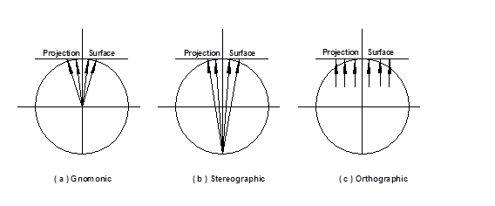
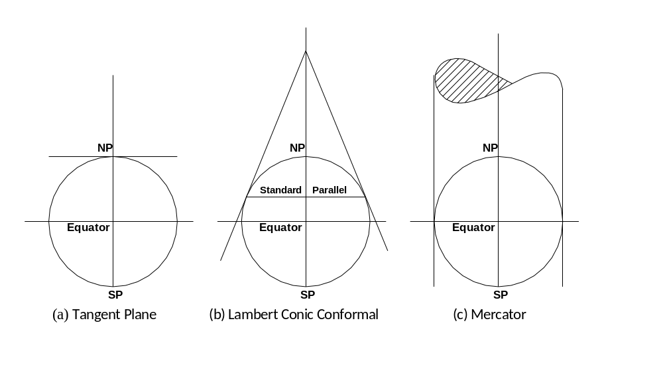
City of Las Cruces – April 24, 2015
Datums, Coordinate Systems, LDPs & the GSDM - Burkholder

Slide 10
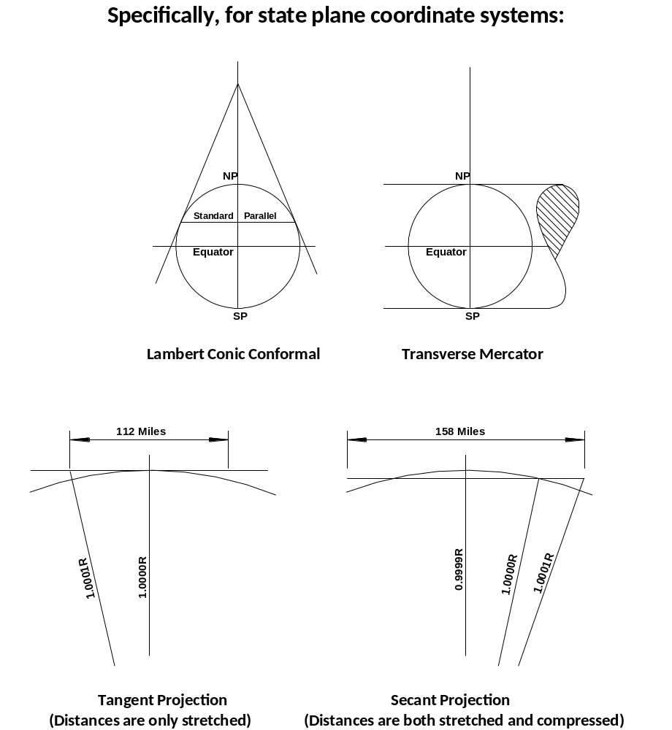
City of Las Cruces – April 24, 2015
Datums, Coordinate Systems, LDPs & the GSDM - Burkholder

Slide 11
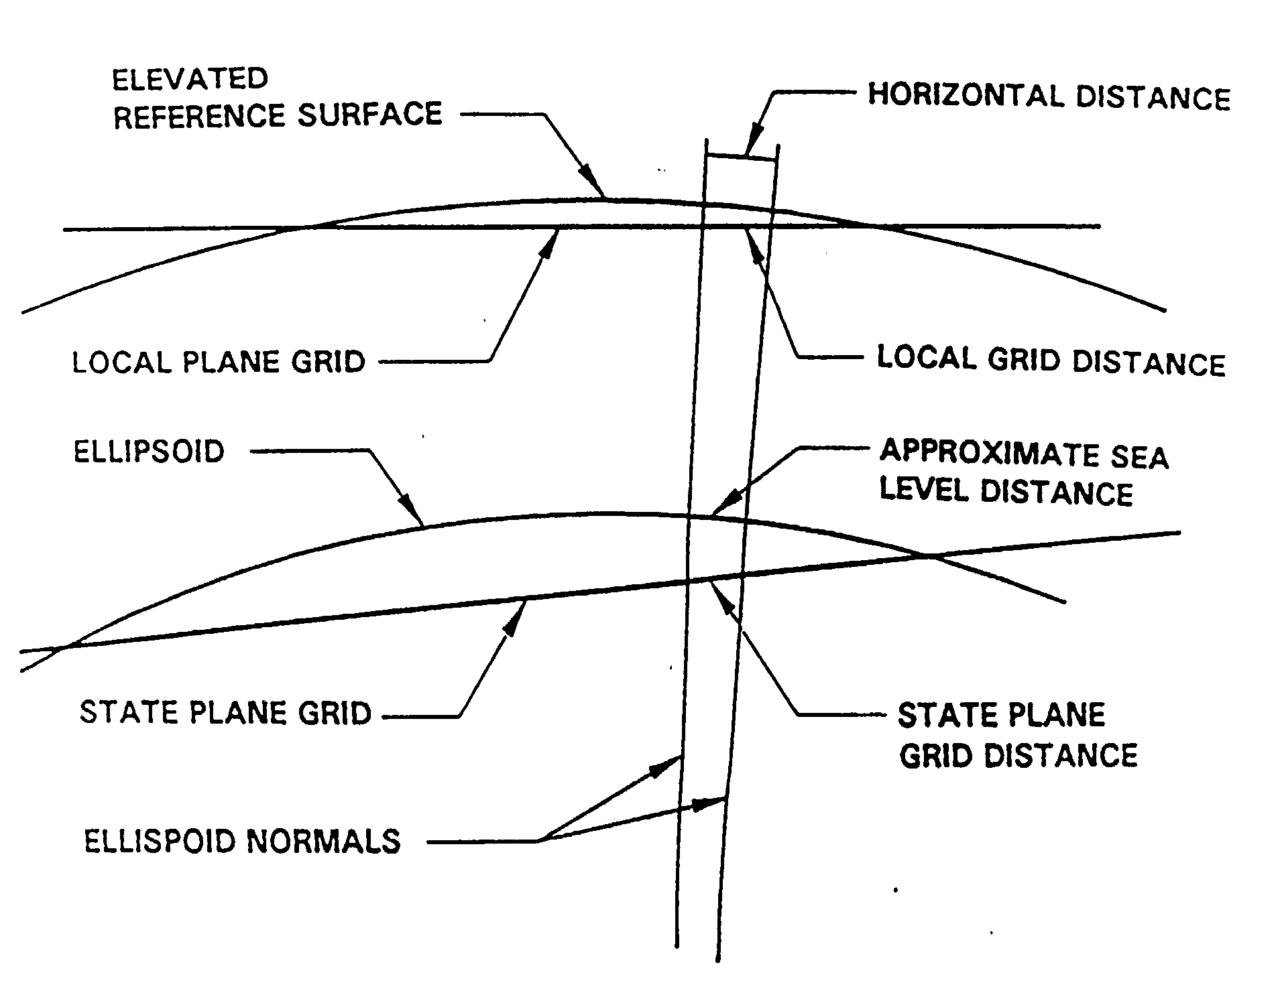
City of Las Cruces – April 24, 2015
Datums, Coordinate Systems, LDPs & the GSDM - Burkholder
- Archival, benefits of information management

Slide 12
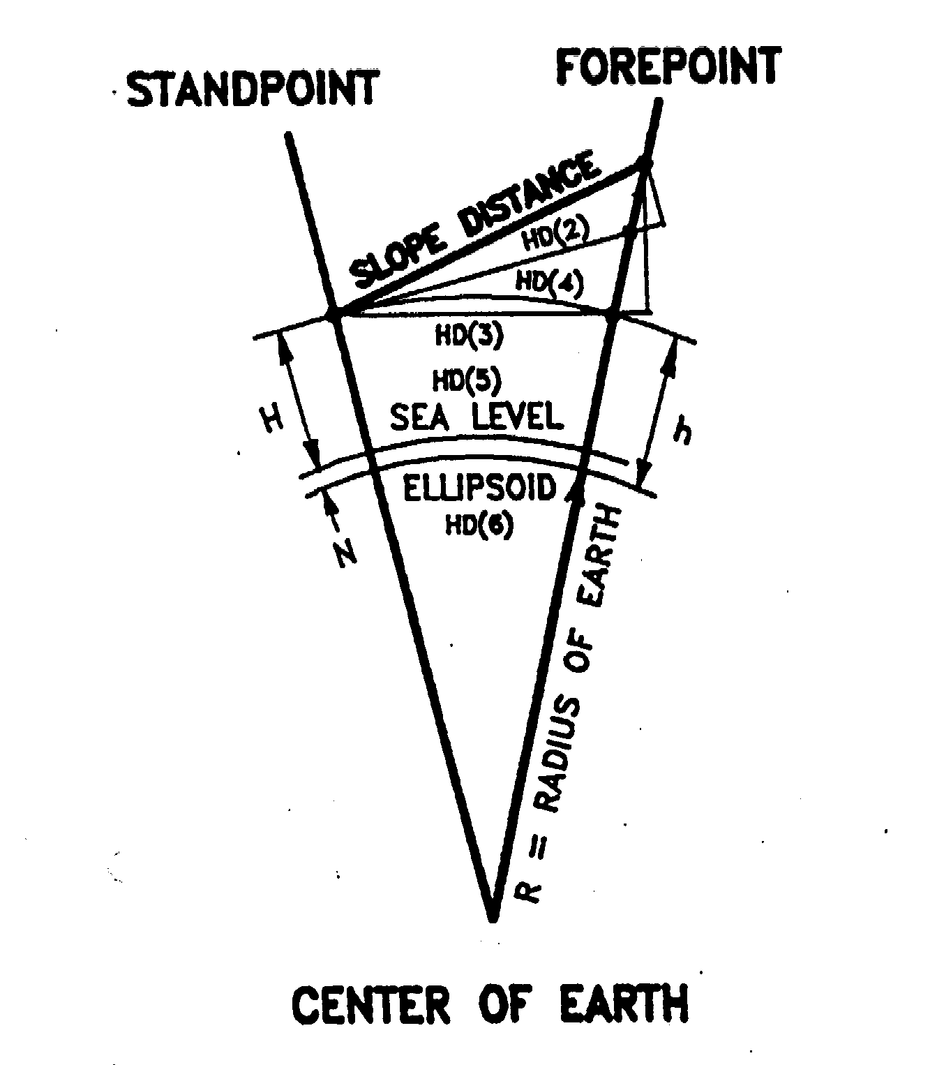
City of Las Cruces – April 24, 2015
Datums, Coordinate Systems, LDPs & the GSDM - Burkholder

Slide 13
City of Las Cruces – April 24, 2015
Datums, Coordinate Systems, LDPs & the GSDM - Burkholder
What is horizontal distance? Several choices are:
1. Right triangle component of slope distance – used the most.
2. Tangent plane distance between plumb lines.
3. Chord with same elevation at both ends.
4. Arc distance between plumb lines.
5. Sea level distance between plumb lines.
6. Ellipsoidal distance between plumb lines.
7. Grid inverse distance between coordinate points – worst choice because then a foot is not a foot!
In most cases, plane surveying uses definition #1

Slide 14
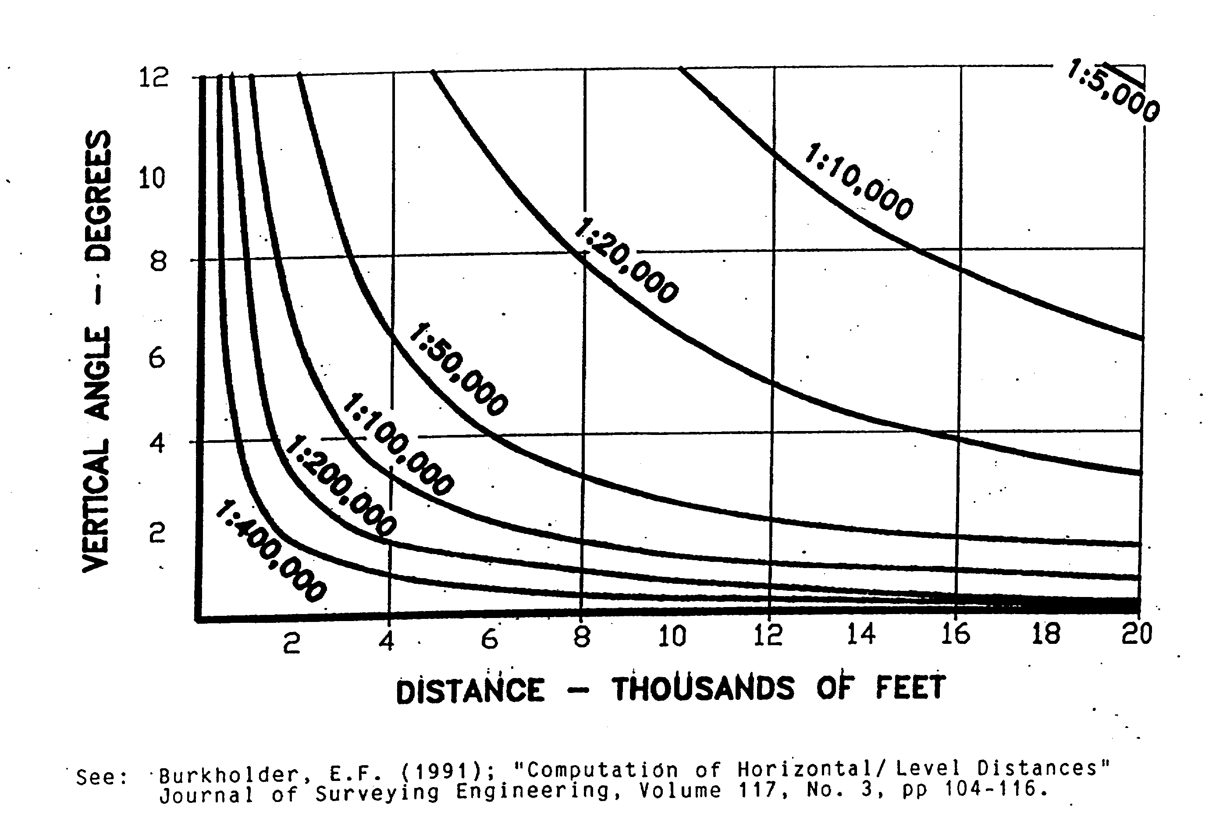
City of Las Cruces – April 24, 2015
Datums, Coordinate Systems, LDPs & the GSDM - Burkholder

Slide 15
City of Las Cruces – April 24, 2015
Datums, Coordinate Systems, LDPs & the GSDM - Burkholder
Points to remember:
Map projections are strictly 2 dimensional.
Conformal map projections are mathematical.
Distances on the map & on the ellipsoid are different.
Distance on ellipsoid is not same as distance on the ground.
When is a foot not a foot? What about weights/measures?
How much distortion is allowed/permitted?
A tolerance of 1:10,000 was adopted in 1930’s.
Corrections are needed to preserve data integrity.
Conformal projections preserve angles.

Slide 16
City of Las Cruces – April 24, 2015
Datums, Coordinate Systems, LDPs & the GSDM - Burkholder
http://www.globalcogo.com/GM012.pdf
Geodetic & geographic (ellipsoidal/spherical)
Computations on ellipsoid or sphere.
Latitude and longitude curvilinear values.
Position in degrees-minutes-seconds.
Equations are cumbersome and complex.
Third dimension is ellipsoid height or altitude.
Elevation has a separate origin.

Slide 17
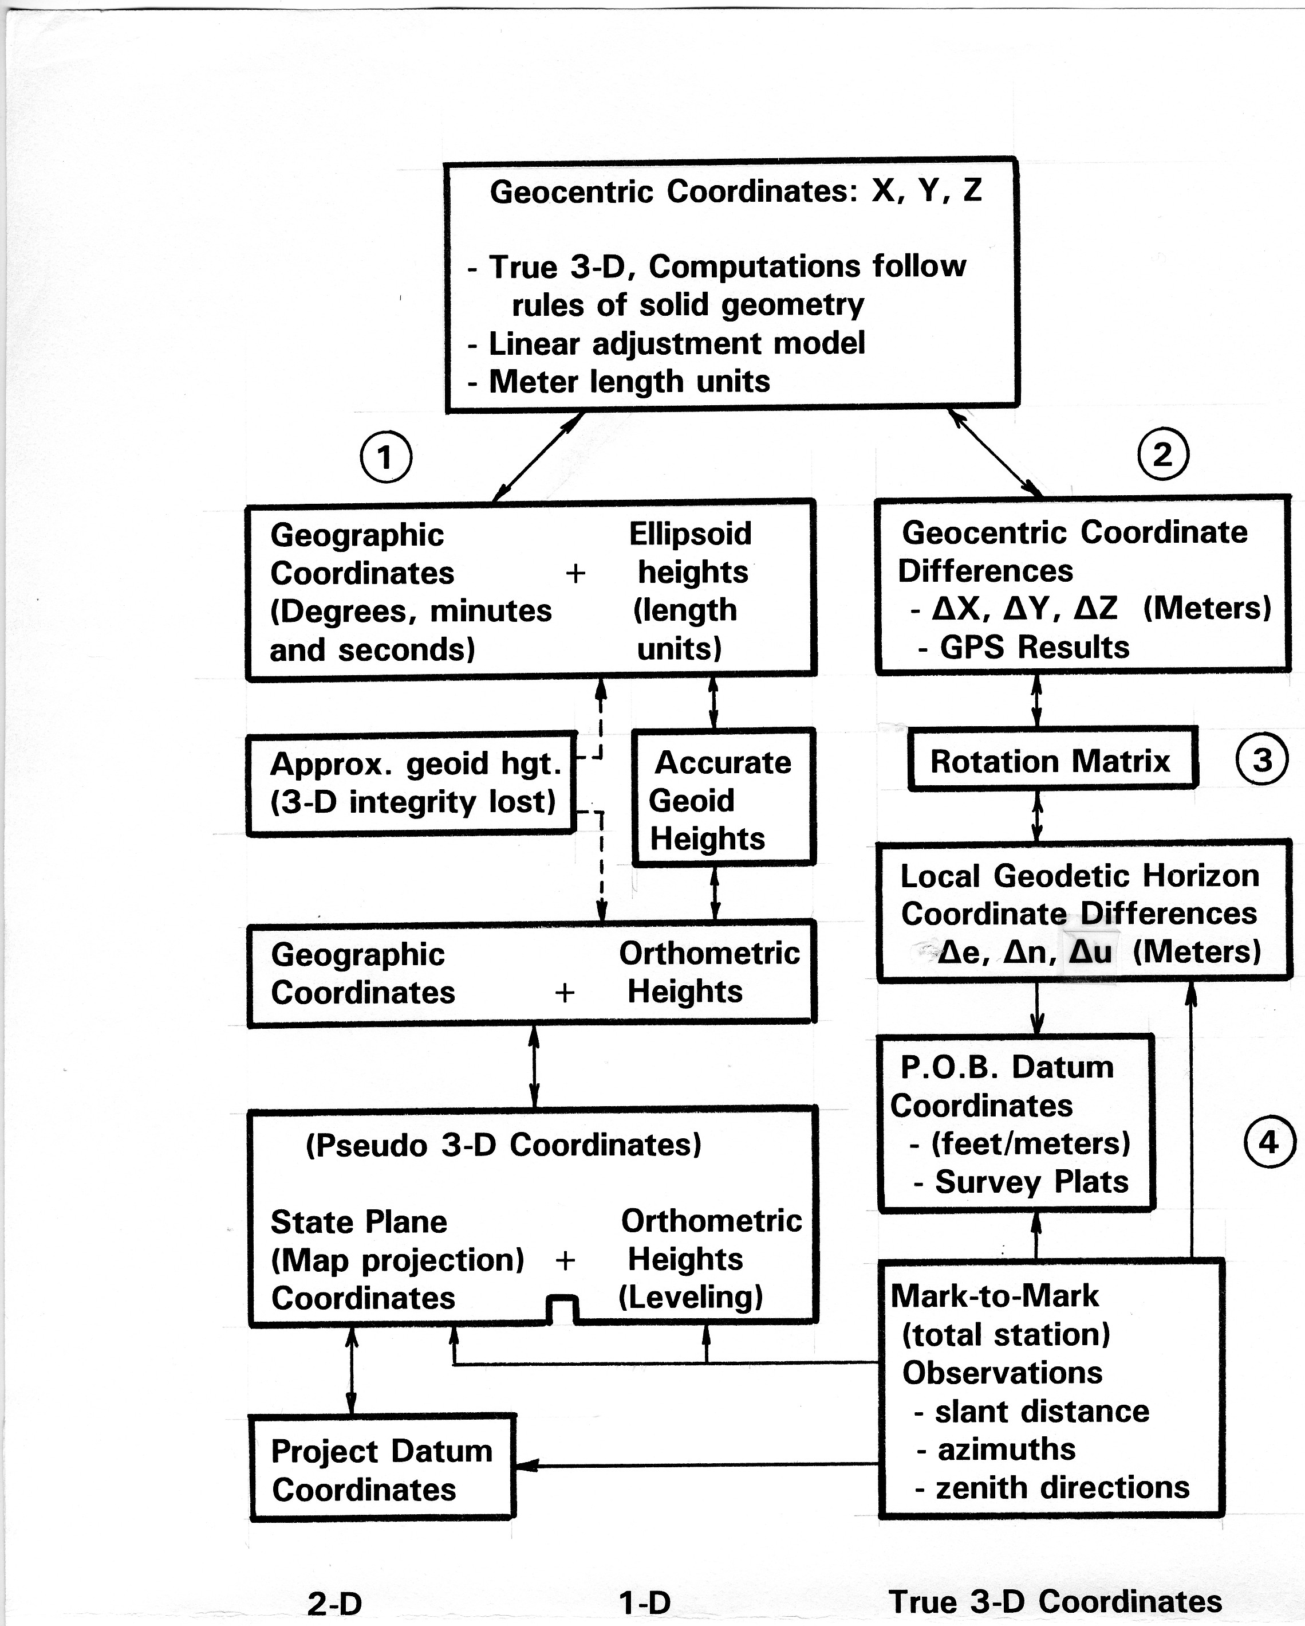
City of Las Cruces – April 24, 2015
Datums, Coordinate Systems, LDPs & the GSDM - Burkholder

Slide 18
City of Las Cruces – April 24, 2015
Datums, Coordinate Systems, LDPs & the GSDM - Burkholder
Coordinate systems/geometry
Coordinate systems:
1. Geocentric, Earth-centered Earth-fixed
2. Geodetic, traditional latitude/longitude.
3. Map projection – state plane coordinates.
4. Local – assumed or modified map projection (LDP)
Basic elements and conventions
- Meter is unit of length (display other as required).
- Use right-handed rectangular as possible.
- Rules of solid geometry (vector algebra & matrices).

Slide 19
City of Las Cruces – April 24, 2015
Datums, Coordinate Systems, LDPs & the GSDM - Burkholder
Points to remember (Again):
Map projections are strictly 2 dimensional.
Map projections are mathematical, not graphical.
Distances on the map & ellipsoid are different.
Distance on ellipsoid is not same as at ground.
When is a foot not a foot?
How much distortion is allowed/permitted?
A tolerance of 1:10,000 was adopted in 1930’s.
Corrections are needed to preserve data integrity.
Conformal projections preserve angles.

Slide 20
City of Las Cruces – April 24, 2015
Datums, Coordinate Systems, LDPs & the GSDM - Burkholder
Questions?

Slide 21
City of Las Cruces – April 24, 2015
Datums, Coordinate Systems, LDPs & the GSDM - Burkholder
Time for a break – be back in 10 minutes.
The first part looked at Datums, Coordinate Systems, and generic Map Projections.
The next part will focus specifically on Low Distortion Projections (LDP’s) and on
The 3-D Global Spatial Data Model (GSDM).

Slide 22
City of Las Cruces – April 24, 2015
Datums, Coordinate Systems, LDPs & the GSDM - Burkholder
Looking specifically at Low Distortion Projections (LDP):
Questions to audience:
- What is a LDP and why are you interested in a LDP?
- How will a LDP be beneficial in your work?
Step back and look at philosophical issues:
- Map projections are the prerogative of Cartographers.
- Cartography is study/practice of making maps – includes:
i. Deciding what is to be mapped.
ii. Representing terrain of objects/features.
iii. Exclude irrelevant information.
iv. Goal is to reduce complexity – generalization.
v. Map design decides what to show.

Slide 23
City of Las Cruces – April 24, 2015
Datums, Coordinate Systems, LDPs & the GSDM - Burkholder
Contrasting roles of cartographer and surveyor
Cartographers are concerned with map model/projection.
(Primarily as discussed on previous/next slide.)
Surveyors/GIS people are concerned with:
- Geometrical integrity of information on the map.
- Deciding what information is to be conveyed.
- Appearance of the map (colors).
- Completeness of information on map.
- Permanence of the information.
- Storage and retrieval of maps.

Slide 24
City of Las Cruces – April 24, 2015
Datums, Coordinate Systems, LDPs & the GSDM - Burkholder
Examples of concerns for Cartographers, Surveyors/GIS, etc.:
Topology is concerned with what lies next to what.
Thematic maps highlight a particular message for reader.
Discrete global grids use pixels - of varying sizes (raster).
Geometrical integrity (vector) is essential for:
- Surveyors/engineers/photogrammetrists/others
What is the impact of the digital revolution?
- For Cartographers?
- For Surveyors/GIS et. al.?
Spatial data are digital and 3-D (4-D if you count time).
This consequence leads to re-examination of many issues.

Slide 25
City of Las Cruces – April 24, 2015
Datums, Coordinate Systems, LDPs & the GSDM - Burkholder
Some of those geometry related issues include:
Measurements are made in 3-D; relative distances.
Reference frame is defined by others – absolute coordinates.
Where is starting place – Point of Beginning (P.O.B.)?
- What is stability/permanence of P.O.B?
- What does it take for selection/use of common P.O.B.?
How can we best provide answers/data to client/public?
- Does client/public know what they want?
- Surveyors provide survey plat/description to landowner.
- And if client/public requests unrealistic results (format)?
- What proprietary considerations are to be made?

Slide 26
City of Las Cruces – April 24, 2015
Datums, Coordinate Systems, LDPs & the GSDM - Burkholder
Examples of projections commonly encountered:
State plane coordinate systems.
- Lambert Conic Conformal for states “long” east/west.
- Transverse Mercator for states “long” north/south.
- Oblique Mercator, central axis at some non-north azimuth
Universal Transverse Mercator (UTM)
- 6 degrees wide, 60 zones around the world
- Grid scale factor 0.9996 (1:2,500) at center of zone.
- Stop short of poles, defined for 80° South to 84° North.
GPS Localization – can be considered a LDP

Slide 27
City of Las Cruces – April 24, 2015
Datums, Coordinate Systems, LDPs & the GSDM - Burkholder

Slide 28
City of Las Cruces – April 24, 2015
Datums, Coordinate Systems, LDPs & the GSDM - Burkholder
Elements needed to define a map projection:
Ellipsoid, semi-major axis and 1/f or semi-minor axis.
Select projection type:
- Tangent/secant
- Lambert, Mercator, Transverse Mercator, Oblique
Fix projection to ellipsoid:
- Central Meridian
- Latitude of origin
- Orientation of mapping grid, Meridian or oblique.
- Level of maximum (plus/minus) distortion allowed.
- Units for distances
- False northing/easting to avoid negative coordinates

Slide 29
City of Las Cruces – April 24, 2015
Datums, Coordinate Systems, LDPs & the GSDM - Burkholder
Low Distortion Projections (see slides 11 and 17 again):
Driving force is to make grid/ground distances similar
(Recognize difficulty of flattening the earth.)
Examples of ways to accomplish that goal (and objections):
- Raise ellipsoid to mean elevation of area to be mapped.
(Some view that practice as using non-standard ellipsoid.)
- Divide existing SPC by combined factor.
(Works well for limited area but coordinates are not SPC.)
- Impose ‘scaling’ on mapping equations.
(Can work well, but departs from formal definitions)
Few users take “ownership” of process but rely on software vendors to provide a system that “works.”

Slide 30
City of Las Cruces – April 24, 2015
Datums, Coordinate Systems, LDPs & the GSDM - Burkholder

Slide 31
City of Las Cruces – April 24, 2015
Datums, Coordinate Systems, LDPs & the GSDM - Burkholder
History of development of LDPs:
For informal summary of LDPs see
www.globalcogo.com/History-LDP.pdf
Michigan SPC 1964
- System designed at 800 feet to avoid elevation reduction
- Reference surface returned to ellipsoid for NAD83.
County Coordinate Systems:
- Wisconsin
- Minnesota
State of Oregon – DOT
- NGS involved in design/adoption
- Probably best example of successful use of LDP.

Slide 32
City of Las Cruces – April 24, 2015
Datums, Coordinate Systems, LDPs & the GSDM - Burkholder
Designing a Low Distortion Projection:
Parameters.
- Use standard GRS80 ellipsoid
- Determine geographic location of area to be covered.
- Determine the average elevation of area.
- Choose projection type:
i. Lambert conic conformal, one or two standard parallels.
ii. Transverse Mercator,
iii. Oblique Mercator,
Computation of zone constants.
- Make sure you are using “reliable” equations.
- Verify your solutions by testing.

Slide 33
City of Las Cruces – April 24, 2015
Datums, Coordinate Systems, LDPs & the GSDM - Burkholder
- Archival, benefits of information management

Slide 34
City of Las Cruces – April 24, 2015
Datums, Coordinate Systems, LDPs & the GSDM - Burkholder
Design a LDP to cover Las Cruces at 1,200.00 m :
Transverse Mercator with maximum distortion 1:100,000.
- Use GRS80 ellipsoid + ellipsoid height at Las Cruces
a = 6,378,137.000 m + 1,200.0 m = 6,379,337.000 m
1/f = 298.25722210088
- Pick Central Meridian (CM) as 106° 45’ 00.”0 W
- Pick latitude of origin as 32° 15’ 00.”0 N
- Choose central scale factor as 0.99999000
- Choose false easting on CM 50,000.0 m
- Choose northing of origin to be 0.000 m
- Use Localcor.exe program – available from EFB.

Slide 35
City of Las Cruces – April 24, 2015
Datums, Coordinate Systems, LDPs & the GSDM - Burkholder
USER: Earl F. Burkholder DATE: April 15, 2015
TRANSVERSE MERCATOR PROJECTION TRANSFORMATIONS
PROJECTION NAME: Las Cruces Seminar April 2015
REFERENCE ELLIPSOID: GEODETIC REFERENCE SYSTEM 1980
a = 6378137.0000 METERS
1/f = 298.2572221008827
REFERENCE ELLIPSOID HEIGHT FOR PROJECTION = 1,200.0000 METERS
MODIFIED ELLIPSOID FOR: Las Cruces Seminar April 2015
a = 6379337.0000 METERS
1/f = 298.2572221008827
ZONE PARAMETERS:
CENTRAL MERIDIAN (W) 106 45 0.000000
LATITUDE OF FALSE ORIGIN 32 15 0.000000
FALSE NORTHING AT FALSE ORIGIN 0.0000 METERS
FALSE EASTING ON CENTRAL MERIDIAN 50,000.0000 METERS
SCALE FACTOR ON CENTRAL MERIDIAN 0.999990000000

Slide 36
City of Las Cruces – April 24, 2015
Datums, Coordinate Systems, LDPs & the GSDM - Burkholder
ZONE CONSTANTS:
RECTIFYING SPHERE RADIUS 6,368,647.1349 METERS
RECTIFYING LATITUDE CONSTANTS:
U(0) = -0.005048250776 V(0) = 0.005022893948
U(2) = 0.000021259204 V(2) = 0.000029370625
U(4) = -0.000000111423 V(4) = 0.000000235059
U(6) = 0.000000000626 V(6) = 0.000000002181
RECTIFYING LATITUDE OF FALSE ORIGIN 32 7 11.489747
GRID MERIDIAN ARC TO FALSE ORIGIN 3570210.5712 METERS
TRANSFORMATIONS:
NAME OF STATION: Reilly FORWARD
LATITUDE: 32 16 55.930010 NORTHING 3,571.6578 METERS
LONGITUDE: 106 45 15.160350 EASTING 49,603.2227 METERS
CONVERGENCE: 0 0 -8.10 SCALE FACTOR: 0.999990001940
NAME OF STATION: CrucesAir FORWARD
LATITUDE: 32 16 54.632690 NORTHING 3,544.8009 METERS
LONGITUDE: 106 55 22.247630 EASTING 33,714.4327 METERS
CONVERGENCE: 0 -5 32.33 SCALE FACTOR: 0.999993268031

Slide 37
City of Las Cruces – April 24, 2015
Datums, Coordinate Systems, LDPs & the GSDM - Burkholder
Example – two NGS published HARN points:
Reilly CrucesAir
ø = 32° 16’ 55.”93001 N ø = 32° 16’ 54.”63269 N
λ = 106° 45’ 15.”16035 W λ = 106° 55’ 22.”24763 W
State Plane Coordinates:
E = 452,506.490 m E = 436,621.577 m
N = 142,268.771 m N = 142,315.959 m
LDP Coordinates:
E(LDP) = 49,603.223 m E(LDP) = 33,714.433 m
N(LDP) = 3,571.658 m N(LDP) = 3,544.801 m
For comparison of inverse distances, see
www.globalcogo.com/SPCvsLDP-LC.pdf

Slide 38
City of Las Cruces – April 24, 2015
Datums, Coordinate Systems, LDPs & the GSDM - Burkholder
Summary of Distances – from link on the previous slide:
Distances from Reilly to CrucesAir
- State plane grid distance 15,884.983 m
- Ground distance (mean elevation) 15,889.066 m
- LDP distance (raw) 15,888.813 m
- LDP distance corrected for CF 15,889.061 m
Observations:
- LDP distance agrees with ground distance 1:62,800
- “Correct” distance from LDP still possible.
- This procedure has nothing to do with vertical.

Slide 39
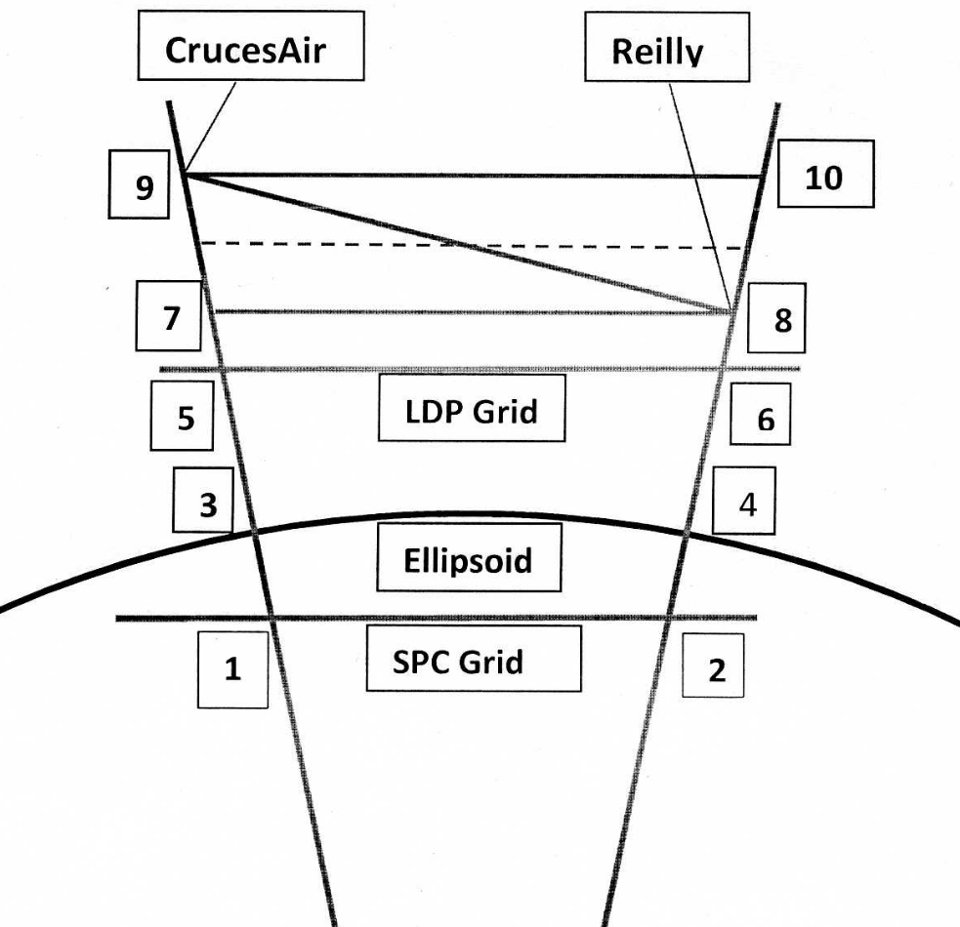
City of Las Cruces – April 24, 2015
Datums, Coordinate Systems, LDPs & the GSDM - Burkholder

Slide 40
City of Las Cruces – April 24, 2015
Datums, Coordinate Systems, LDPs & the GSDM - Burkholder
With regard to the diagram on the previous slide:
Points 1 & 2 State plane coordinate inverse.
Points 3 & 4 Ellipsoid distance (arc & chord “same”).*
Points 5 & 6 Horizontal distance from LDP.
Points 7 & 8 Actual horizontal distance at Reilly.**
Points 9 & 10 Actual horizontal distance at CrucesAir.**
Dotted line is “mean” horizontal distance.
Real question is “what definition of horizontal is to be used?”
* In this case, arc is longer than the chord by 0.004 m.
** HD(3) has same ellipsoid height at both ends (see slide 12).

Slide 41
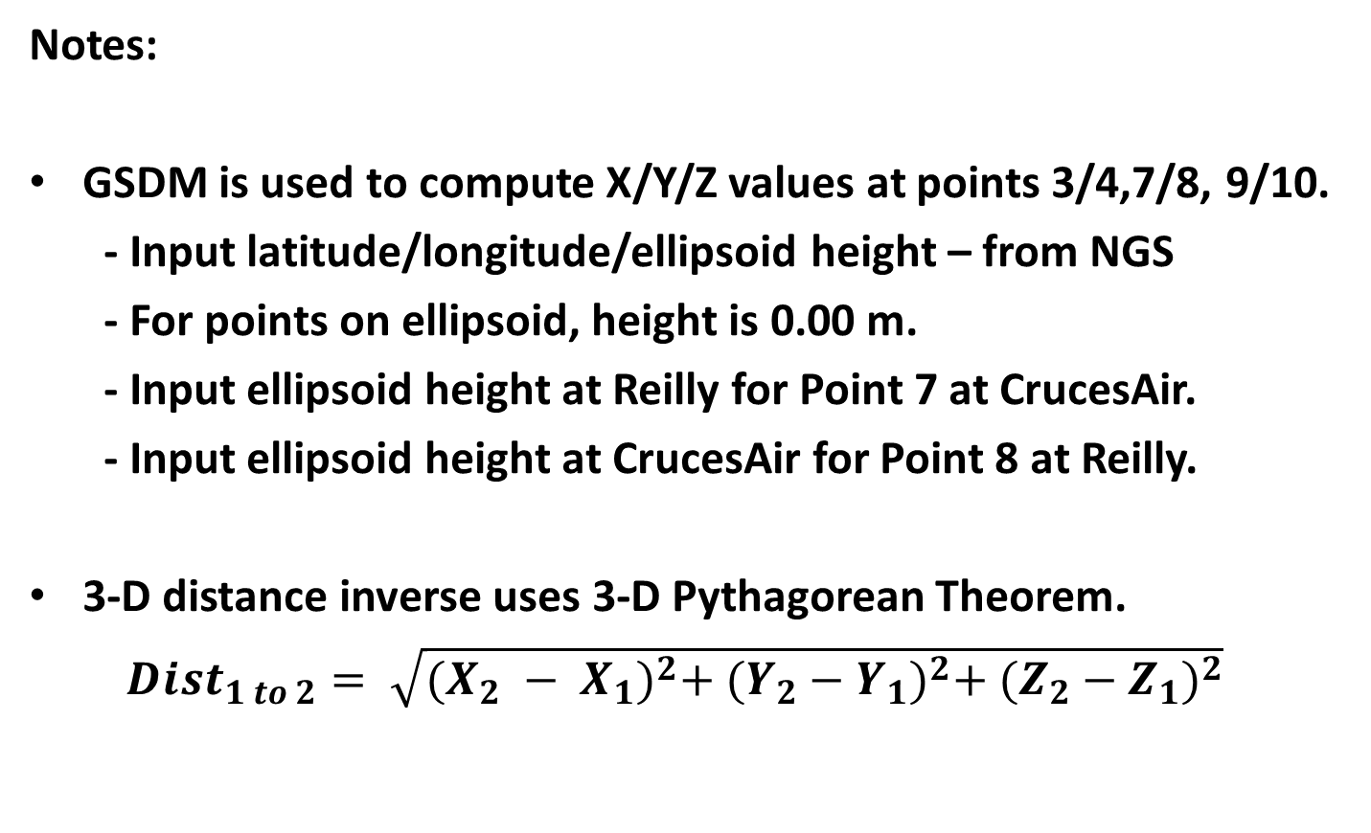
City of Las Cruces – April 24, 2015
Datums, Coordinate Systems, LDPs & the GSDM - Burkholder
Notes:
GSDM is used to compute X/Y/Z values at points 3/4,7/8, 9/10.
- Input latitude/longitude/ellipsoid height – from NGS
- For points on ellipsoid, height is 0.00 m.
- Input ellipsoid height at Reilly for Point 7 at CrucesAir.
- Input ellipsoid height at CrucesAir for Point 8 at Reilly.
3-D distance inverse uses 3-D Pythagorean Theorem.
${Dist}_{1 to 2}= \sqrt{{(X_{2} − X_{1})}^{2}+ {(Y_{2}−Y_{1})}^{2}+ {(Z_{2}−Z_{1})}^{2}}$

Slide 42
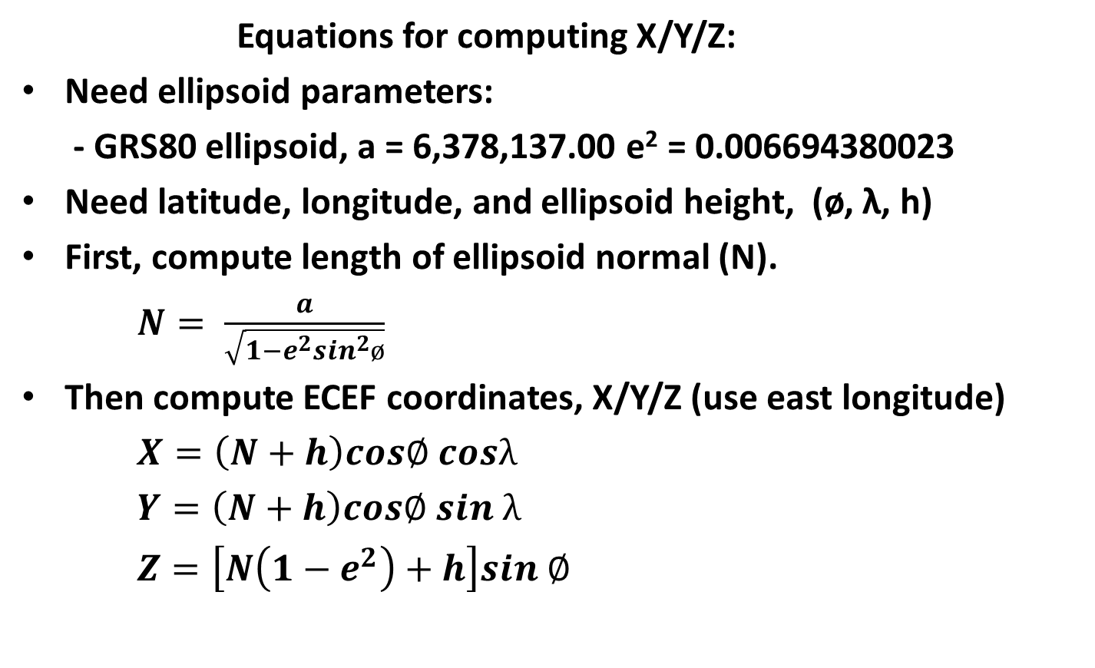
City of Las Cruces – April 24, 2015
Datums, Coordinate Systems, LDPs & the GSDM - Burkholder
Equations for computing X/Y/Z:
Need ellipsoid parameters:
- GRS80 ellipsoid, a = 6,378,137.00 e² = 0.006694380023
Need latitude, longitude, and ellipsoid height, (ø, λ, h)
First, compute length of ellipsoid normal (N).
$N= \frac{a}{\sqrt{1−e^{2}\sin^{2}ø}}$
Then compute ECEF coordinates, X/Y/Z (use east longitude)
$X=\left(N+h\right)cos∅ cosλ$
$Y=\left(N+h\right)cos∅ sin λ$
$Z=\left[N\left(1−e^{2}\right)+h\right]sin ∅$

Slide 43
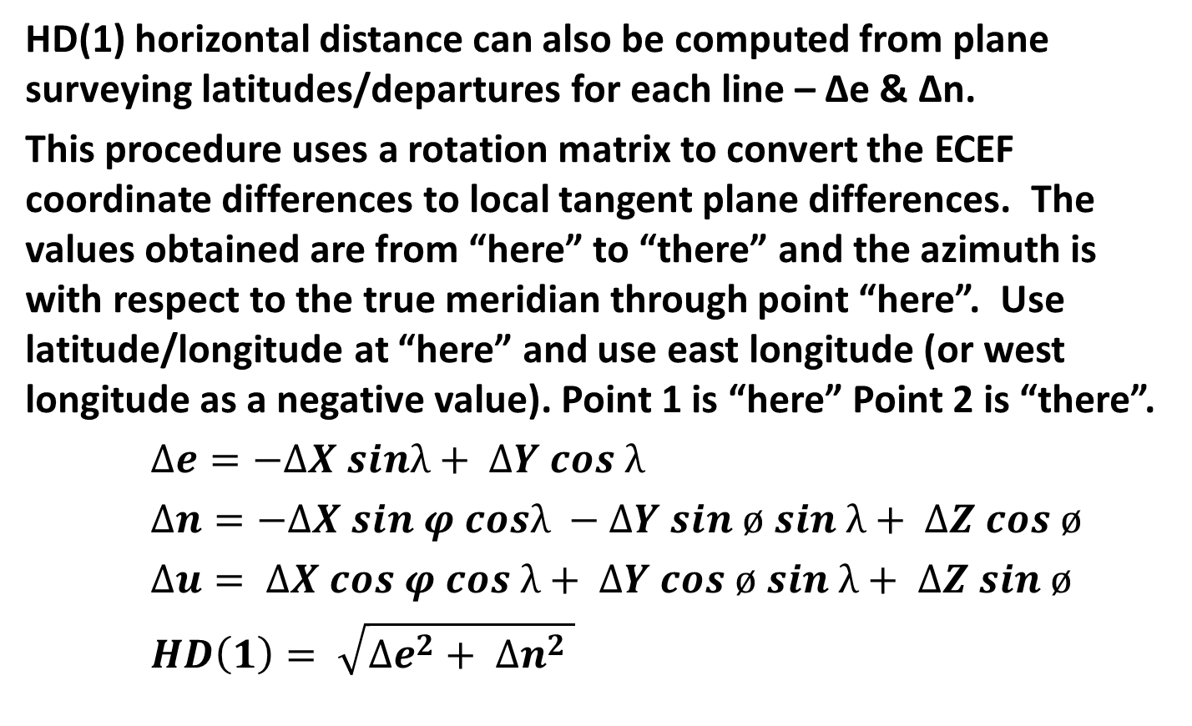
City of Las Cruces – April 24, 2015
Datums, Coordinate Systems, LDPs & the GSDM - Burkholder
HD(1) horizontal distance can also be computed from plane surveying latitudes/departures for each line – Δe & Δn.
This procedure uses a rotation matrix to convert the ECEF coordinate differences to local tangent plane differences. The values obtained are from “here” to “there” and the azimuth is with respect to the true meridian through point “here”. Use latitude/longitude at “here” and use east longitude (or west longitude as a negative value). Point 1 is “here” Point 2 is “there”.
$∆e=−∆X sinλ+ ΔY cos λ$
$∆n=−∆X sin φ cosλ −ΔY sin ø sin λ+ ΔZ cos ø$
$∆u= ∆X cos φ cos λ+ ΔY cos ø sin λ+ ΔZ sin ø$
$HD\left(1\right)= \sqrt{{∆e}^{2}+ {∆n}^{2} }$

Slide 44
City of Las Cruces – April 24, 2015
Datums, Coordinate Systems, LDPs & the GSDM - Burkholder
Now we have a different set of comparisons to make but without the approximations for grid scale factor or computing the elevation factor. And, we can now carry vertical as well.
Using the 3-D Pythagorean Theorem:
- Ellipsoid distance is 15,885.949 + 0.004 m = 15,885.953 m
- HD(3) at Reilly is = 15,888.863 m
- HD(3) at CrucesAir is = 15,889.261m
- Mean distance is = 15,889.062 m
Using the rotation matrix:
- HD(1) Reilly to CrucesAir is = 15,889.248 m
- HD(1) CrucesAir to Reilly is = 15,888.851 m
- Mean distance is = 15,889.050 m

Slide 45
City of Las Cruces – April 24, 2015
Datums, Coordinate Systems, LDPs & the GSDM - Burkholder
Some conclusions/points: The user is responsible for correct use!
1. Surveyors are responsible for measurements.
2. GIS persons use measurements and specify how.
3. It is impossible to portray a curved earth on a flat map to scale without distortion.
4. Traditional computations are performed on ellipsoid or grid.
5. GSDM performs computations in 3-D space without distortion.
6. A LDP can be used effectively (if documented and followed).
7. The GSDM accommodates 3-D – LDP only 2-D
8. Not covered in this seminar – but the GSDM handles error propagation and standard deviations with aplomb.
9. Extensive documentation on-line at www.globalcogo.com

Slide 46
City of Las Cruces – April 24, 2015
Datums, Coordinate Systems, LDPs & the GSDM - Burkholder
Questions?
FYI –
Power point file at www.globalcogo.com/LC-Sem.pptx
PDF file at www.globalcogo.com/LC-Sem.pdf
Don’t forget Evaluations!
Thank you for coming!

