Slide 1
Underground (Well) Mapping Re-visited by: Earl F. Burkholder, PS, PE, F.ASCE
Global COGO, Inc. – Las Cruces, NM 88003
Email: eburk@globalcogo.com
URL: www.globalcogo.com
ASCE Shale Energy Engineering Conference
Pittsburgh, PA July 20-23, 2014
For pdf file of full paper as submitted – see www.globalcogo.com/underground-mapping.pdf

Slide 2
ASCE Shale Energy Engineering Conference
Pittsburgh, PA – July 20-23, 2014
Author: Earl F. Burkholder, PS, PE, F.ASCE:
Retired college professor.
Promotes using 3-D via the Global Spatial Data Model (GSDM)
Career includes:
- 5 years “large” corporate projects.
- 25 years teaching college level geomatics courses.
- 10 years self employed.
Textbook “The 3-D Global Spatial Data Model” © 2008
Develops algorithms/software for:
- 3-D coordinate geometry
- Error propagation

Slide 3
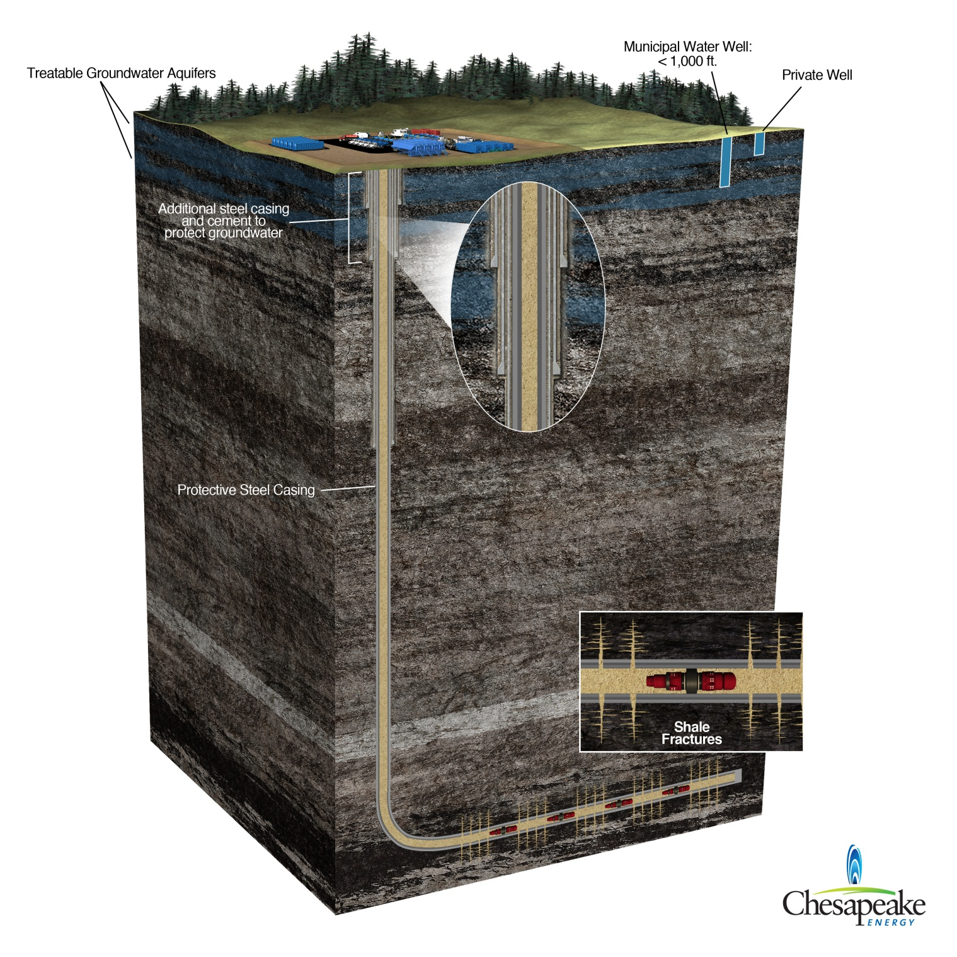
Image courtesy of Chesapeake Energy

Slide 4
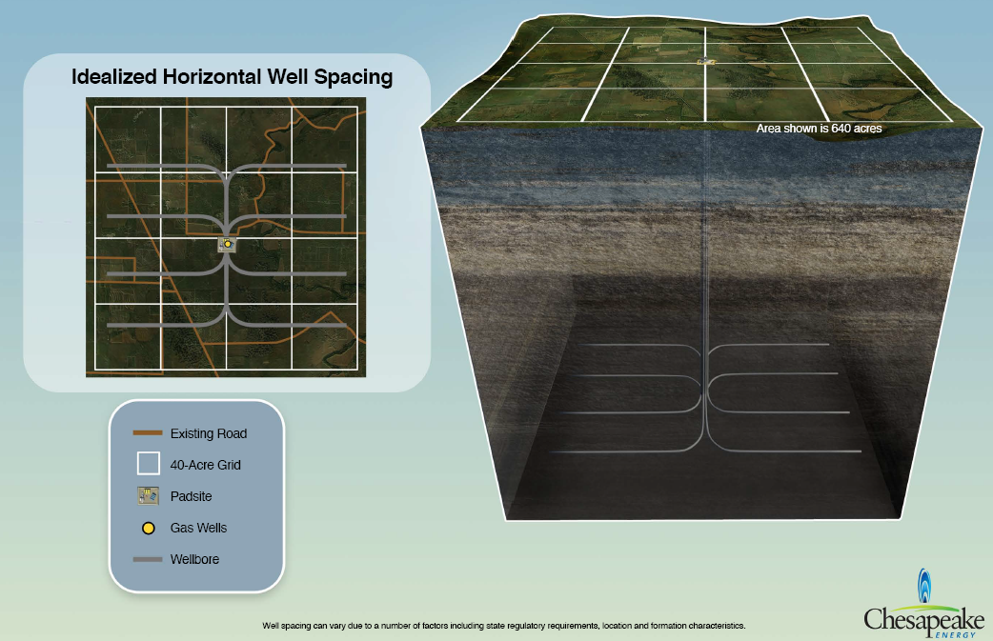
Image Courtesy of Chesapeake Energy

Slide 5
ASCE Shale Energy Engineering Conference
Pittsburgh, PA – July 20-23, 2014
ISCWSA standard is “Introduction to Wellbore Positioning” by Professor Angus Jamison, University of the Highlands & Islands.
http://www.uhi.ac.uk/en/research-enterprise/energy/wellbore-positioning-download
This re-visit is based on the assumption of a single origin for 3-D data. See book, “The 3-D Global Spatial Data Model: Foundation of the Spatial Data Infrastructure” written by Earl F. Burkholder and published by CRC Press in April 2008.
Google “ISBN 9781420063011”
Prototype 3-D Coordinate Geometry and Error Propagation software is called “BURKORDTM” and available gratis at -
www.globalcogo.com/WBK3D.html

Slide 6
ASCE Shale Energy Engineering Conference
Pittsburgh, PA – July 20-23, 2014
Introduction:
Digital Revolution – impacts all facets of life/practice (BIG DATA)
Surveying to Geomatics to Spatial Data (abstraction)
Geospatial (survey) data:
Are referenced to planet Earth.
Coordinate systems include:
- Latitude and longitude
- Map projections and plane coordinates
- Geocentric Earth-centered, Earth-fixed (ECEF) X/Y/Z
Absolute values with respect to well-defined reference frame.
Essential in GIS systems for managing location information.
Local flat-earth systems with named origin/orientation.

Slide 7
ASCE Shale Energy Engineering Conference
Pittsburgh, PA – July 20-23, 2014
Background
Concepts:
- Mercator gave the world conformal maps in 1569.
- René Descartes codified solid geometry in 1637.
- Grinter Report provides vision for future - 1955.
Practice:
- Rectangular Cartesian coordinates on flat-Earth.
i). 2-D horizontal.
ii). 1-D vertical.
- Analog information is shown on maps (and photographs).
- Modern practice trends to using digital 3-D geospatial data.
Analog to digital transition contains many challenges.

Slide 8
ASCE Shale Energy Engineering Conference
Pittsburgh, PA – July 20-23, 2014
Digital Revolution – as related to mapping/surveying data:
Computers:
- Mainframe – ever since late 1950s.
- Microprocessor – ever since 1960s.
- Hand-held – ever since 1970s. Now in smart phones.
Electronic measuring devices - dictated by environment.
Photogrammetry (and imaging) – analog and soft-copy.
GPS for navigation, location, mapping, surveying.
Pulse lasers for tracking, terrestrial scanning, LiDAR.
Step back and examine 3-D models for:
- Spatial data – relative (engineering/design/construction).
- Geospatial data – absolute (GIS/analysis/management).

Slide 9
ASCE Shale Energy Engineering Conference
Pittsburgh, PA – July 20-23, 2014
As applied to underground (well) mapping:
Local coordinate system based on flat-earth assumptions
- Assumed origin
- Oriented to north (true/magnetic/grid)
- Correctly portrays local 3-D relationships
- Works quite nicely in (local) digital environment
Geo-referencing offers advantages (in some cases mandated?)
- Uniqueness of location
- Pieces fit into larger picture
- Archival, benefits of information management

Slide 10
ASCE Shale Energy Engineering Conference
Pittsburgh, PA – July 20-23, 2014
Reconciling “local” with “geo-referencing”
Conventional practice is to use map projections; SPC, UTM, etc
- 2-D mapping plane is well defined.
- Coordinate geometry same as in plane surveying
- Orientation can be true or grid north
- Latitude/longitude can be readily computed as needed.
Disadvantages/challenges:
- Map projections are 2-dimensional. What about elevation?
- Geometrical integrity suffers with increasing depth due to:
i). mapping distortion inherent in projection.
ii). elevation factor - an issue regardless of projection.

Slide 11
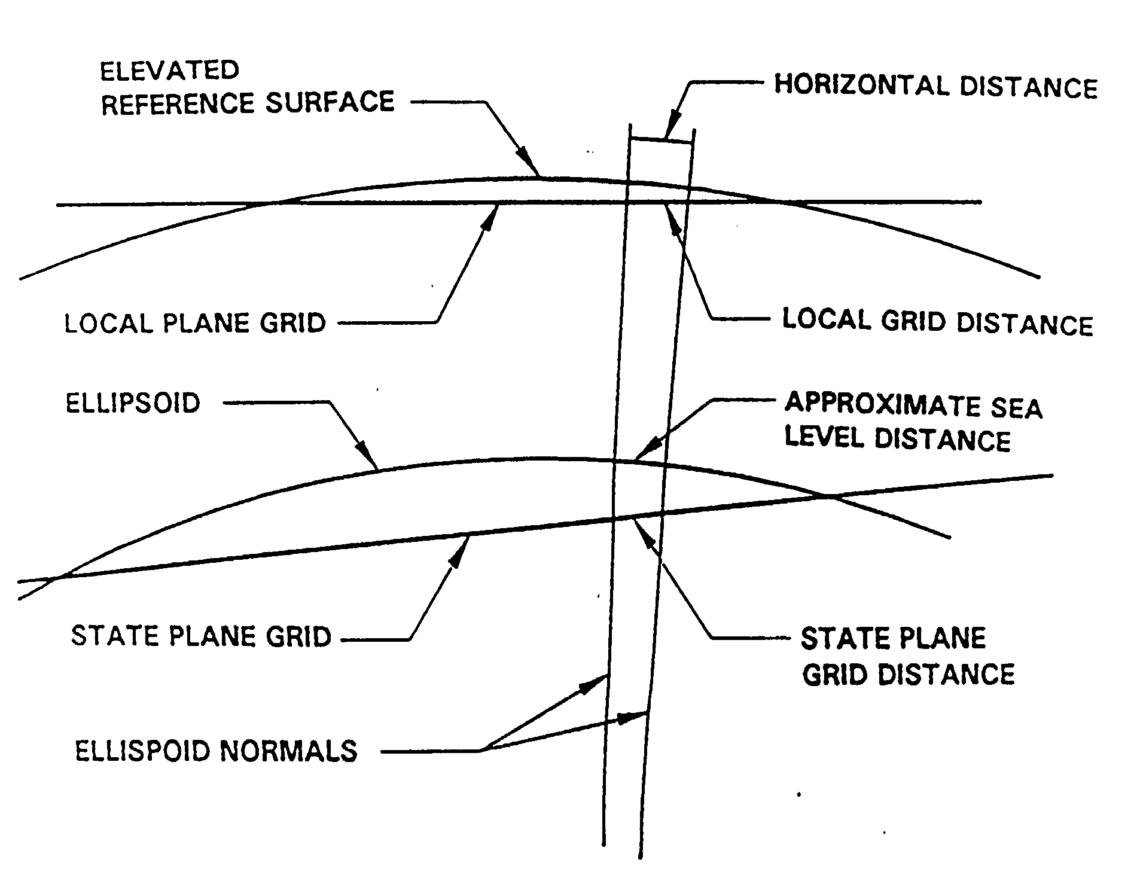
ASCE Shale Energy Engineering Conference
Pittsburgh, PA – July 20-23, 2014
- Archival, benefits of information management

Slide 12
ASCE Shale Energy Engineering Conference
Pittsburgh, PA – July 20-23, 2014
Issues are discussed in 2000 paper by Williamson & Wilson:
“Directional Drilling and Earth Curvature”
Directional drilling companies planning extended-reach wells should estimate physical error introduced by the model and compare it with target tolerances.
Developers of directional & survey software should consider an improved methodology (such as described in their paper) for inclusion in their products.
Well locations could be represented by 3D geocentric Cartesian coordinates. That advantage is outweighed by the awkward fact that none of those axes are parallel with the vertical.

Slide 13
ASCE Shale Energy Engineering Conference
Pittsburgh, PA – July 20-23, 2014
Those existing issues/challenges are addressed by the GSDM!
The 3-D Global Spatial Data Model (GSDM):
- Uses Earth-centered Earth-fixed geocentric coordinates.
- Is well-defined and already implemented.
- Includes a rotation matrix that aligns axes with vertical.
Advantages of using the GSDM include:
- 3-D geometrical integrity is preserved in all cases.
- Local flat-Earth practices are accommodated.
- There are no projection parameters or zone constants.
- There are no boundaries from one system to another.
- Error propagation computations are fully supported.

Slide 14
ASCE Shale Energy Engineering Conference
Pittsburgh, PA – July 20-23, 2014
The GSDM uses three coordinate systems:
Geodetic latitude/longitude/ellipsoid height
- Uses Deg-Min-Sec for latitude and longitude
- Uses meters for ellipsoid height
Geocentric rectangular Earth-centered Earth-fixed (ECEF)
- Origin is Earth’s center of mass
- X/Y lie in the plane of the Equator
- Z axis aligned with Earth’s spin axis (very nearly so)
Local (Flat-Earth)
- Origin is any place selected by the user.
- Orientation is true north (or grid north if defined).
- Meter units in data base but other units may be displayed.

Slide 15
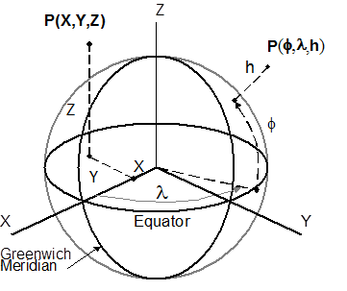
ASCE Shale Energy Engineering Conference
Pittsburgh, PA – July 20-23, 2014
Geodetic and geocentric coordinate systems are both shown.

Slide 16
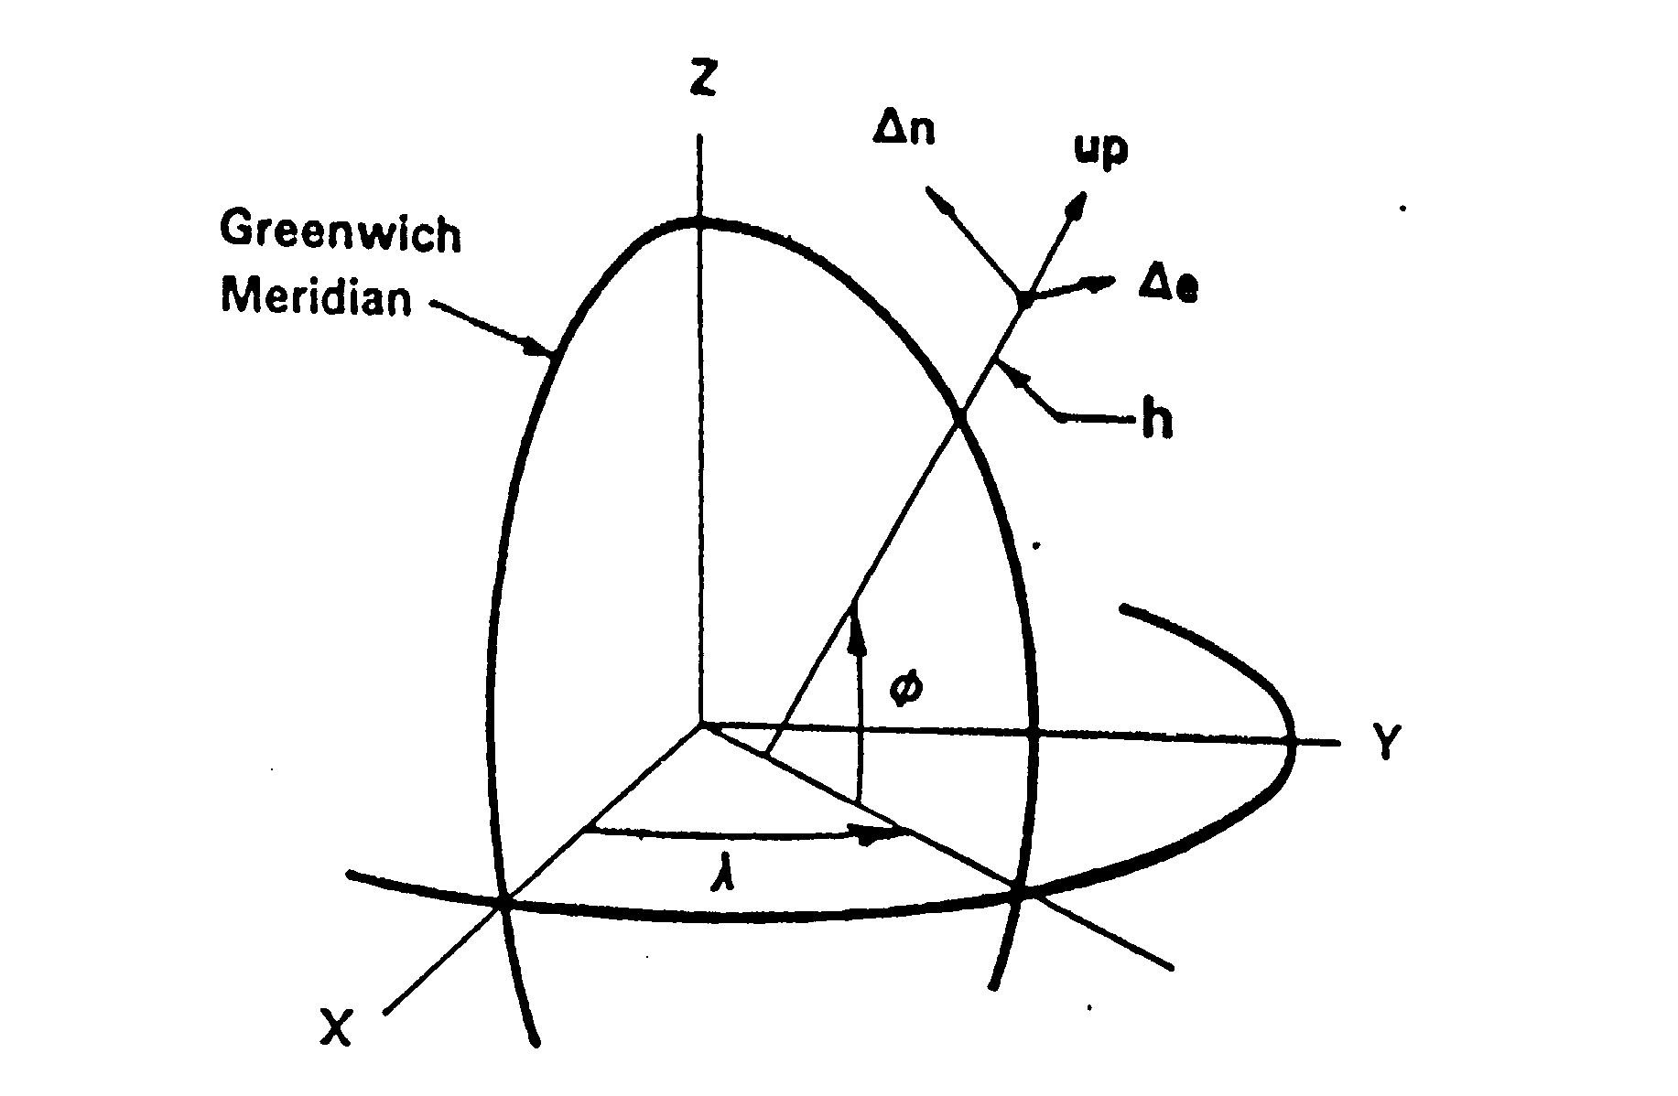
ASCE Shale Energy Engineering Conference
Pittsburgh, PA – July 20-23, 2014
Local Coordinate System – Global View

Slide 17
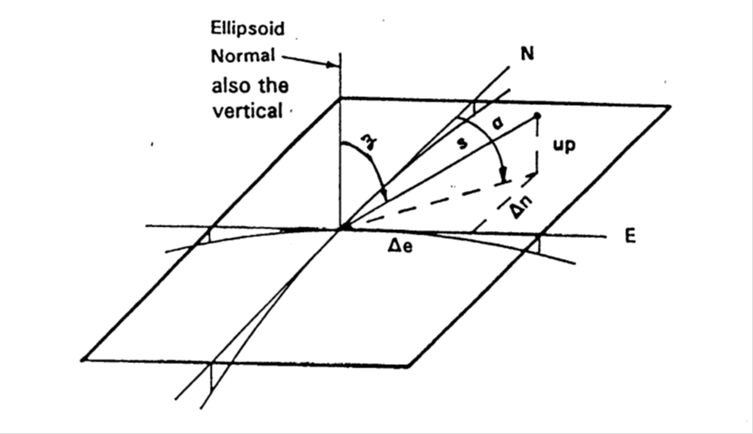
ASCE Shale Energy Engineering Conference
Pittsburgh, PA – July 20-23, 2014
Local coordinate system – local view

Slide 18
ASCE Shale Energy Engineering Conference
Pittsburgh, PA – July 20-23, 2014
Features of the GSDM include:
Rules of solid geometry – rectangular metric coordinates
Rotation matrix lets user to work with local e/n/u components
Inverse point to point provides:
- local tangent plane horizontal distance
- azimuth is geodetic (true) from meridian at standpoint
Practical use of the GSDM:
Start with known point – X/Y/Z (ECEF) or 0/0/0 (local)
Use measurements as in current practice
Compute local Δe/Δn/Δu components and rotate to ΔX/ΔY/ΔZ
Add ΔX/ΔY/ΔZ values to ECEF coordinates in data base
Compute inverses from ΔX/ΔY/ΔZ rotated to local Δe/Δn/Δu

Slide 19
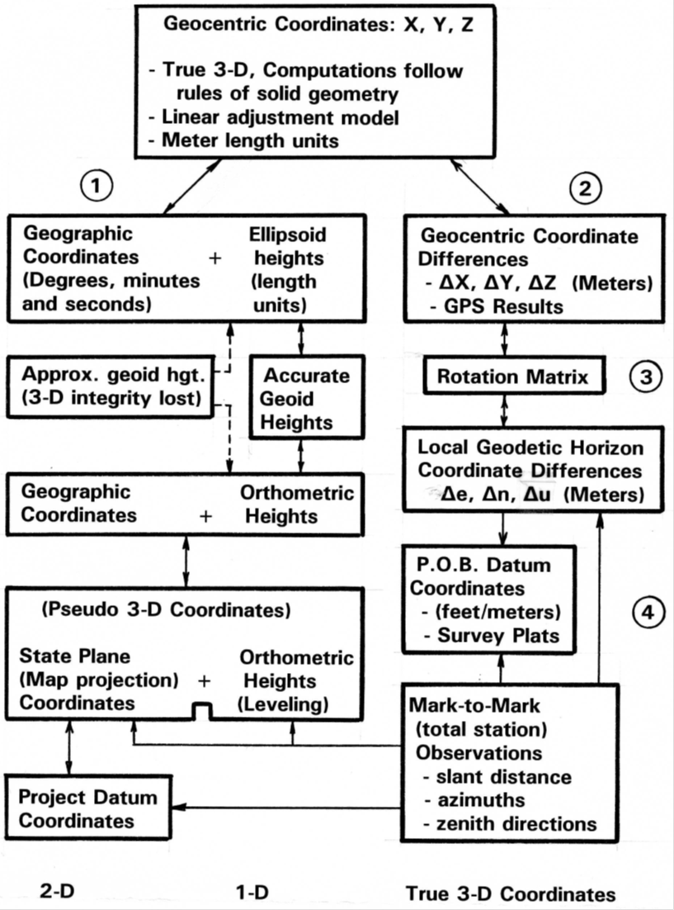
ASCE Shale Energy Engineering Conference
Pittsburgh, PA – July 20-23, 2014

Slide 20
ASCE Shale Energy Engineering Conference
Pittsburgh, PA – July 20-23, 2014
Conceptual Considerations:
Functional model includes equations, geometry, & coordinates
- Measurements reduced to local components
i). Distances
ii). Azimuth/tilt
iii). Physical sensors – temperature/voltage/etc.
- Rules of solid geometry
Stochastic model includes uncertainty & error propagation
- No measurement is perfect – it has a standard deviation.
- Error accumulates from one measurement to the next.
- Error propagation provides a way to track accumulation
- Knowing size of error is important for quality decisions.

Slide 21
ASCE Shale Energy Engineering Conference
Pittsburgh, PA – July 20-23, 2014
Issues of spatial data accuracy (with respect to what?):
Absolute (network) accuracy
- How good are the coordinates or elevations?
- Determined from error propagation computations
Relative (local) accuracy
- What is the relative position of one point wrt another?
- Closely related to quality of the measurements.
- Often portrayed using error ellipses – 2-D
Research focuses on correlation within covariance matrices.
(See www.globalcogo.com/StdDevLocalNetwork.pdf )

Slide 22
ASCE Shale Energy Engineering Conference
Pittsburgh, PA – July 20-23, 2014
Conceptual Considerations:
Absolute quantities – related to “reference frame” values
- Essential for managing information (wrt the big picture)
- Compare one data set with another
- Used in storage and archival practices
Relative quantities – related to the measurements
- What is location of this point with respect to that one?
(Points plotted on a map provide overall picture of location.)
- What is the location of this point with respect to:
i). Where it was yesterday, last year, some other epoch?
ii). In other words, did it move?
IT SHOULD GO WITHOUT SAYING, RELATIVE ON THE SAME DATUM.

Slide 23
ASCE Shale Energy Engineering Conference
Pittsburgh, PA – July 20-23, 2014
Details of the GSDM have been published & are readily available from various sources. In addition to references at the end of the paper, many items are posted at:
www.globalcogo.com/refbyefb.html
In particular, Geometrical concepts of the GSDM were described in a paper presented at the “First Congress on Computing in Civil Engineering” – June 20-24, 1994.
www.globalcogo.com/first-ce-computing.pdf
A 1-page summary of the 3-D challenge is posted at:
www.globalcogo.com/challenge.pdf

Slide 24
ASCE Shale Energy Engineering Conference
Pittsburgh, PA – July 20-23, 2014
Conclusions - the GSDM provides methods by which:
Existing measurements can be used to compute:
- Relative location – already being done.
- Absolute positions in true 3-D position.
Error propagation of measurements are used to compute:
- The standard deviation of each coordinate position.
- The standard deviation of any point with respect to any
other point in the data set.
All well location data can be reliably geo-referenced.

Slide 25
ASCE Shale Energy Engineering Conference
Pittsburgh, PA – July 20-23, 2014
Acknowledgements – I owe many thanks to the following persons who assisted in development and revisions of this paper:
Barbara Whitten, ASCE Manager Technical Committees
(Geomatics and Energy)
Chuck Hookham, 2012 Chair, ASCE Energy Division
David Garber, 2013-14 Chair, ASCE Geomatics Division
David M. Baker, Senior Advisor, Geosciences Technology,
Chesapeake Energy Corporation
Anonymous reviewers
Thank you for your attendance and attention – EFB.

Slide 26
ASCE Shale Energy Engineering Conference
Pittsburgh, PA – July 20-23, 2014
References:
Burkholder, E.F., 2013; “Standard Deviation and Network/Local Accuracy of Geospatial Data, U.S. Copyright Office, Wash. D.C.
www.globalcogo.com/StdDevLocalNetwork.pdf
Burkholder, E.F., 2008; “The 3-D Global Spatial Data Model,” Taylor & Francis, CRC Press, Boca Raton, London, New York.
Burkholder, E.F.; “Elevations and the Global Spatial Data Model,” Proceedings of 58th Annual Meeting of The Institute of Navigation and CIGTF 21st Guidance Symposium, Albuquerque, NM, 217-222.
Burkholder, E.F., 1997; “Definition and Description of a Global Spatial Data Model,” U.S. Copyright Office, Washington D.C.
www.globalcogo.com/gsdmdefn.pdf
Williamson, H.S. & H.F. Wilson, 2000; “Directional Drilling and Earth Curvature,” SPE Drill & Completion, 15 (1), 37-43.

